Slide 2



NGS Solutions – Applications
NGS Solutions – Market
NGS Solutions – Tailor made

Slide 3
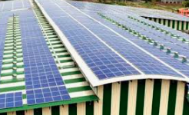
rooftop
rooftop
rooftop
Application

Slide 4
water
land
APPLICATION
rooftop
carshed
carport

Slide 5
pharma
textile
mining
MARKETS
food & beverage
commercial
auto
mobile
industrial

Slide 6




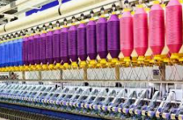



Slide 7
Tailor Made
Solutions
Instant
layout
BOM

Slide 8
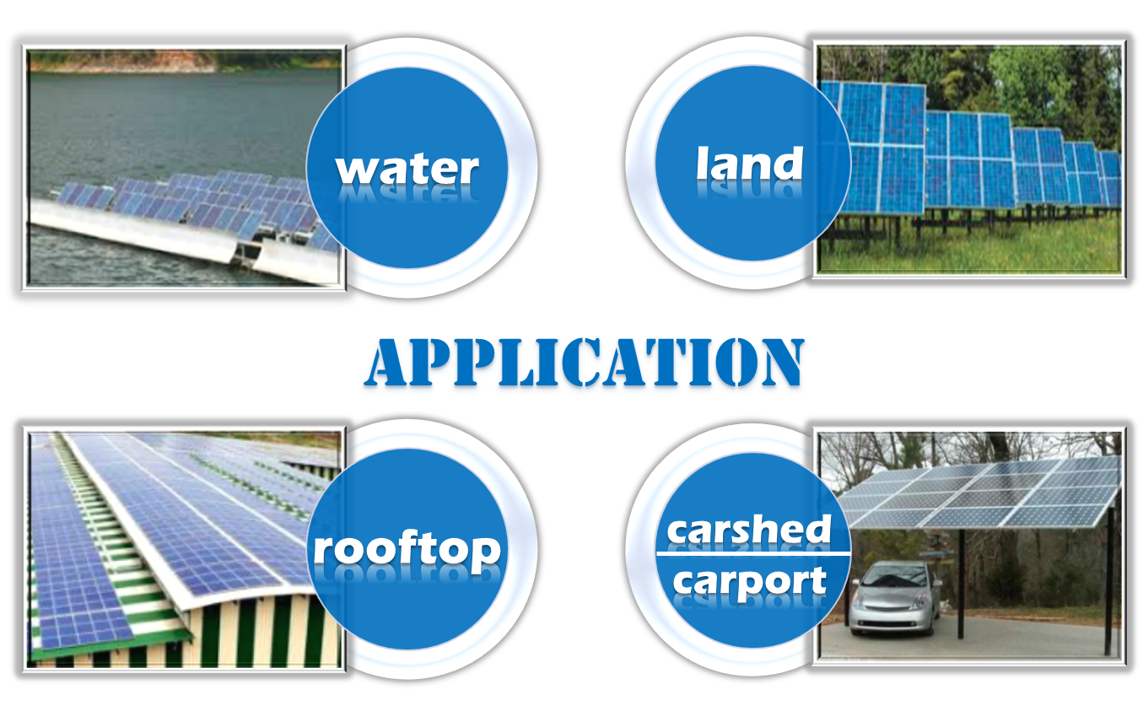
NGS -
SOLUTIONS

Slide 9

NGS -
SOLUTIONS
NGS -
SOLUTIONS

Slide 10

NGS -
SOLUTIONS

Slide 11
NGS - SOLUTIONS

Slide 12

NGS - SOLUTIONS

